Slide 1
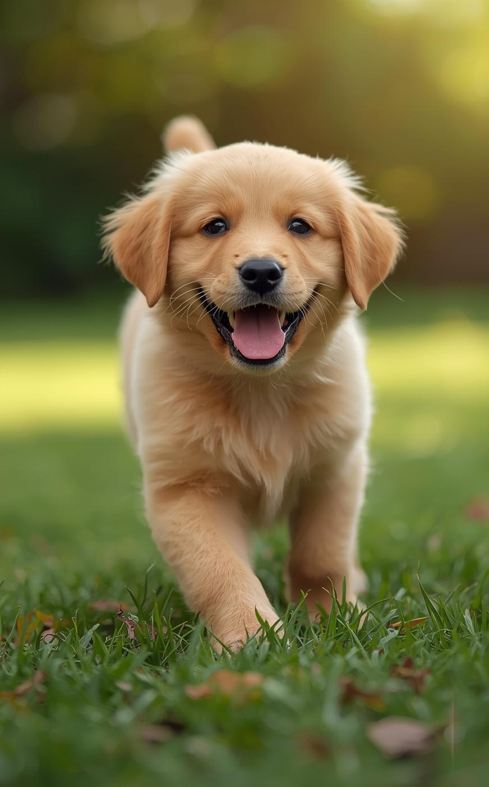

DOG LOVERS UNITED
Discovering Our Loyal Companions
Presented by Tuhina Chris Sherlin B

Slide 2
ssssssssssss

Slide 3

Introduction to Dogs
Our Beloved Companions
Dogs have been our loyal companions for thousands of years, valued for their loyalty, intelligence, and unique abilities. They hold a significant place in our culture and bring joy to countless lives.

Slide 4
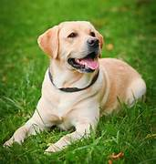
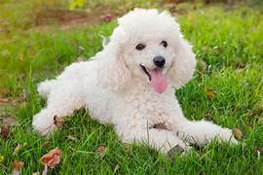
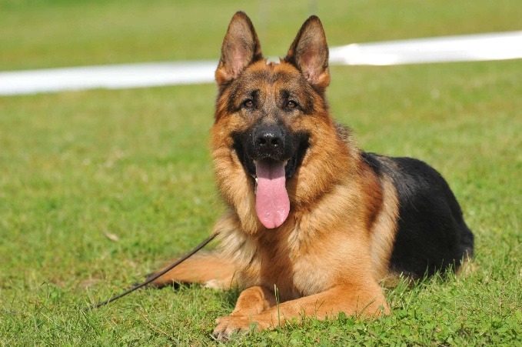
Popular Dog Breeds
Discovering Their Unique Traits
Labrador Retriever
Poodle
German Shepherd
The Labrador Retriever is known for its friendly disposition, intelligence, and sociability, making it an ideal family pet. They are energetic and require regular exercise to thrive and stay healthy.
Poodles come in standard, miniature, and toy sizes, showcasing intelligence and elegance. They are hypoallergenic, making them a great choice for families with allergies, and excel in obedience training.
The German Shepherd is highly regarded for its loyalty and protective instincts. This breed is versatile, excelling in various roles like service, working, and companionship, requiring consistent training and socialization.

Slide 5
Understanding Dog Behavior
Insights into canine communication
Tail Wagging
Barking
Body Language
Tail wagging is a friendly gesture that indicates happiness and excitement in dogs. The position and speed of the wag can reveal different emotions, making it a vital communication tool.
Barking serves as a dog's vocal communication, expressing various feelings. Dogs may bark to alert, play, or seek attention, and understanding the context helps in responding appropriately to their needs.
Dogs communicate significantly through body language, including posture, ear position, and facial expressions. Observing these cues can help owners identify their dog's emotions and improve the bond between them.

Slide 6
Dog Care Essentials
Key components for happy dogs
Proper Nutrition
Regular Grooming
Daily Exercise
A well-balanced diet is crucial for a dog’s health, providing necessary nutrients for energy, growth, and overall well-being. Consult a vet for specific dietary needs based on age and breed.
Grooming helps maintain a dog’s coat and skin health. Regular brushing prevents matting and reduces shedding, while baths keep your dog clean and comfortable, enhancing their overall appearance.
Exercise is essential for a dog’s physical and mental health. Regular walks, playtime, and outdoor activities enrich their lives, prevent boredom, and help manage weight by promoting active lifestyles.

Slide 7
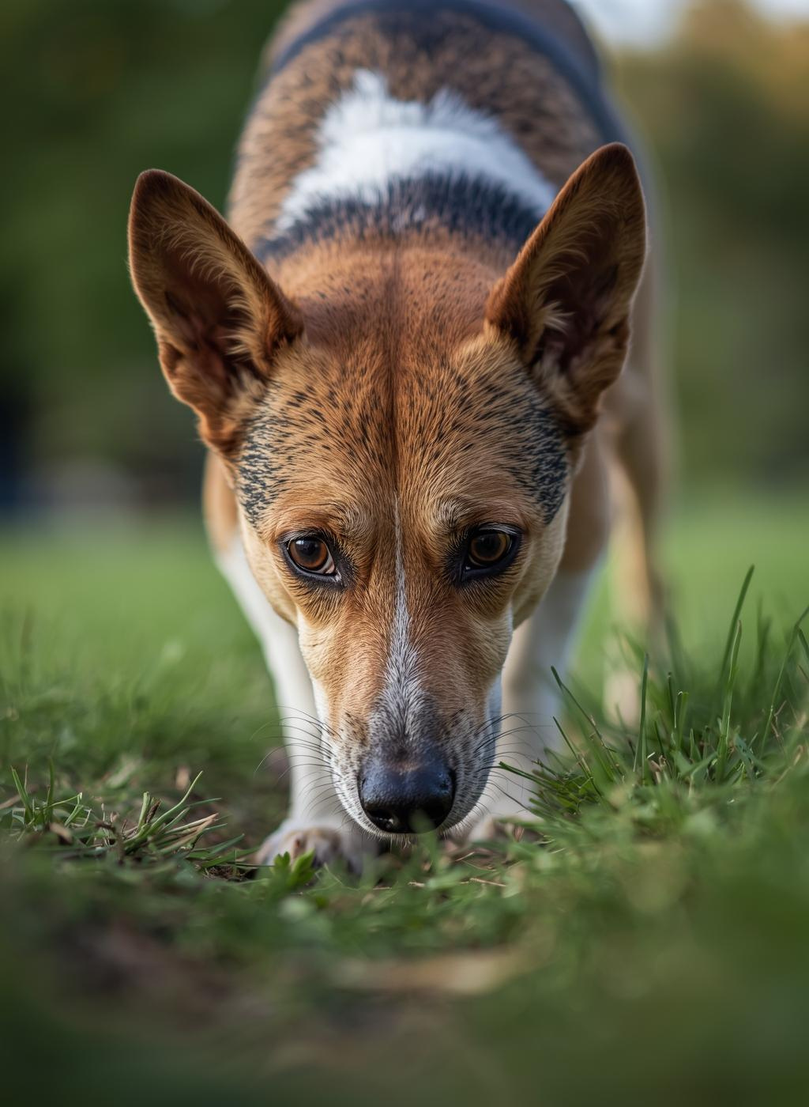
Fun Facts About Dogs
Discover the amazing capabilities of dogs
Dogs possess an extraordinary sense of smell, capable of detecting scents at incredibly low concentrations, which makes them valuable in search and rescue operations, as well as assisting in medical diagnoses.

Slide 8
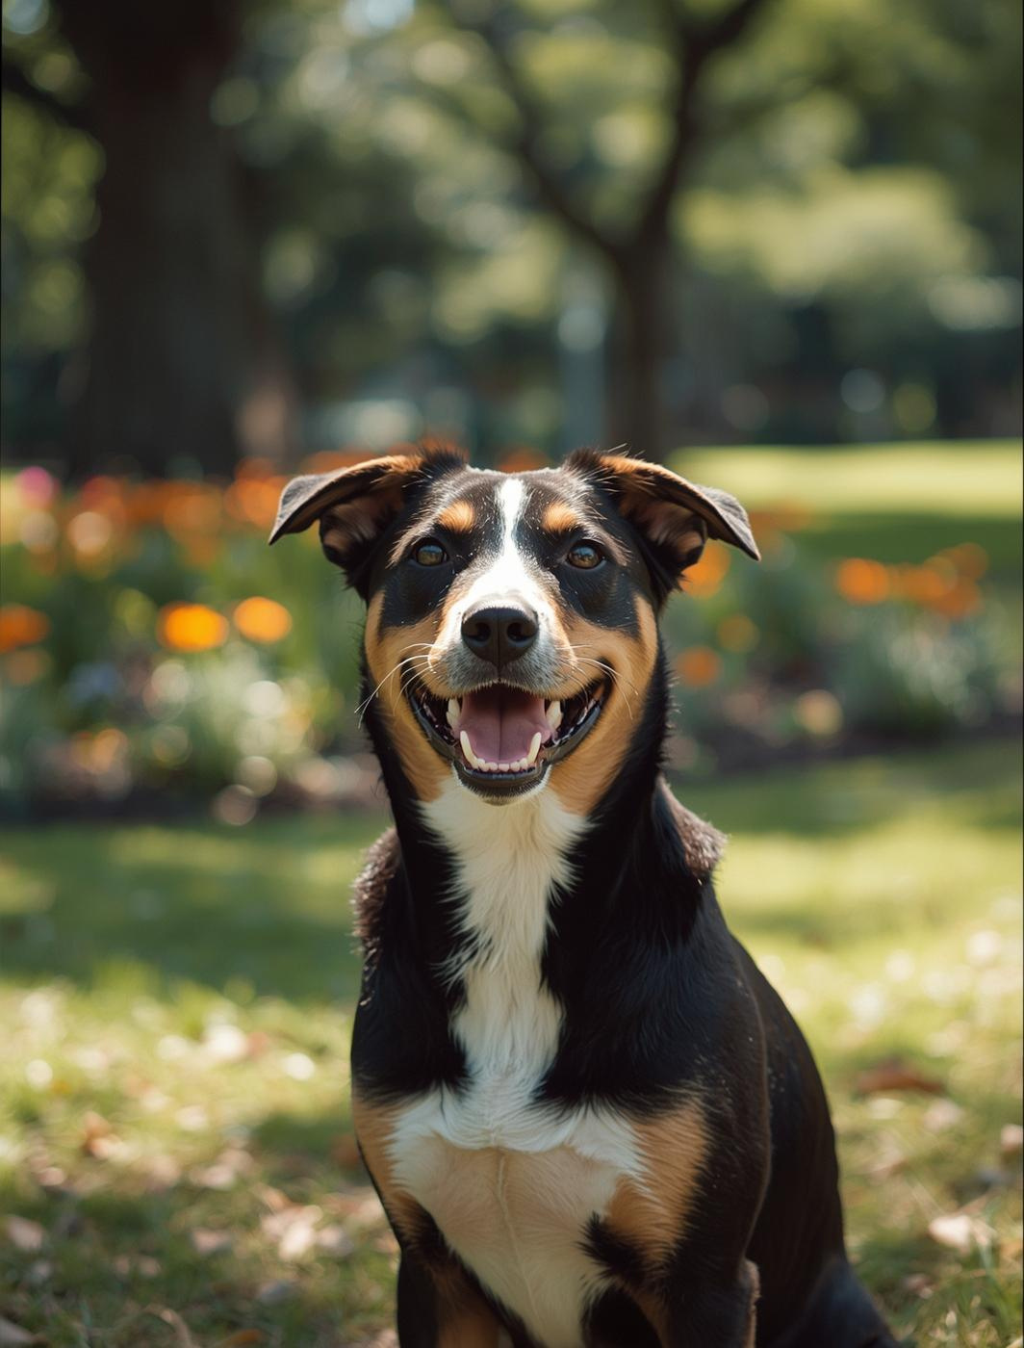

Thank You for Attending!
We appreciate your love for dogs and their care!

